Slide 1

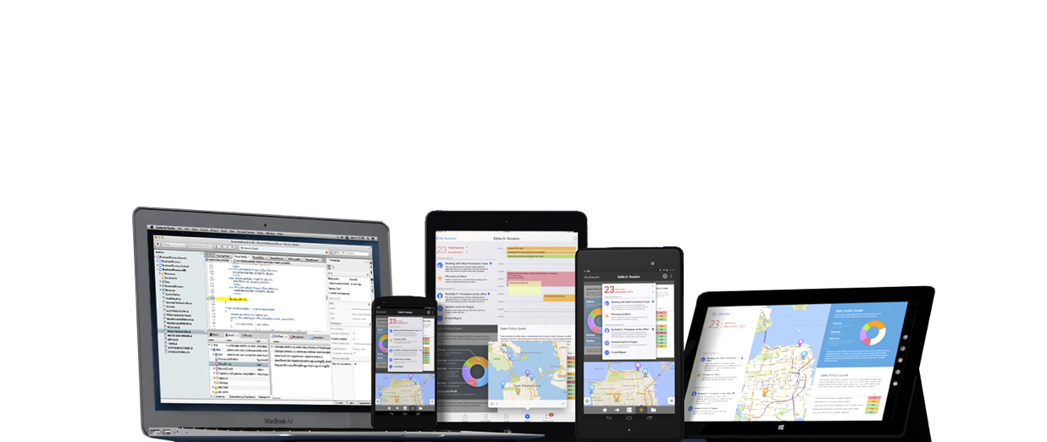
Mike Berlin
Customer Success Engineer
@mikeberlin
mike-berlin.com
github.com/mikeberlin
C# on 2.6 billion devices

Slide 2
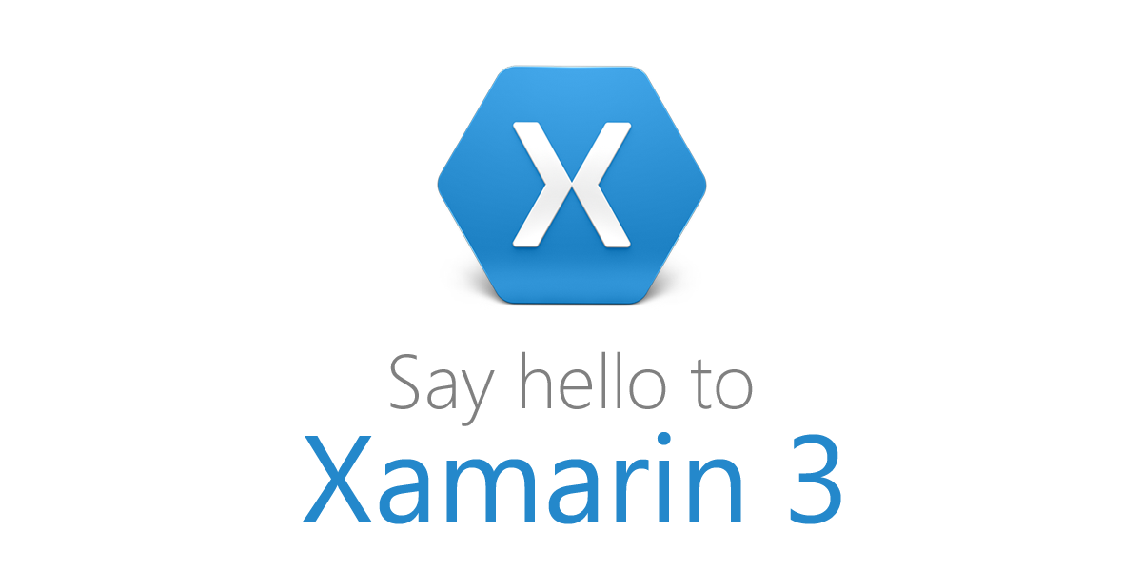
Notes:
We are here to talk about all the brand new features packed into Xamarin 3.
Xamarin 3 is a combination of over a years worth of Xamarin development and everything we demo here today is what you get when you install or update xamarin today!
Before we get into Xamarin 3 let’s talk a bit out Xamarin and how

Slide 3



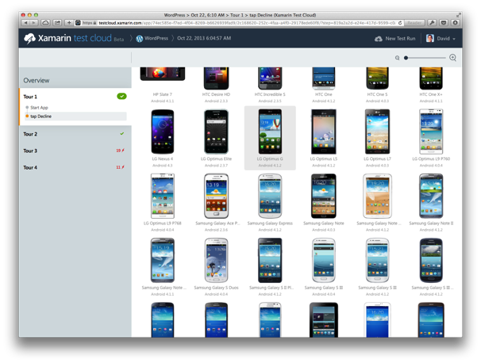
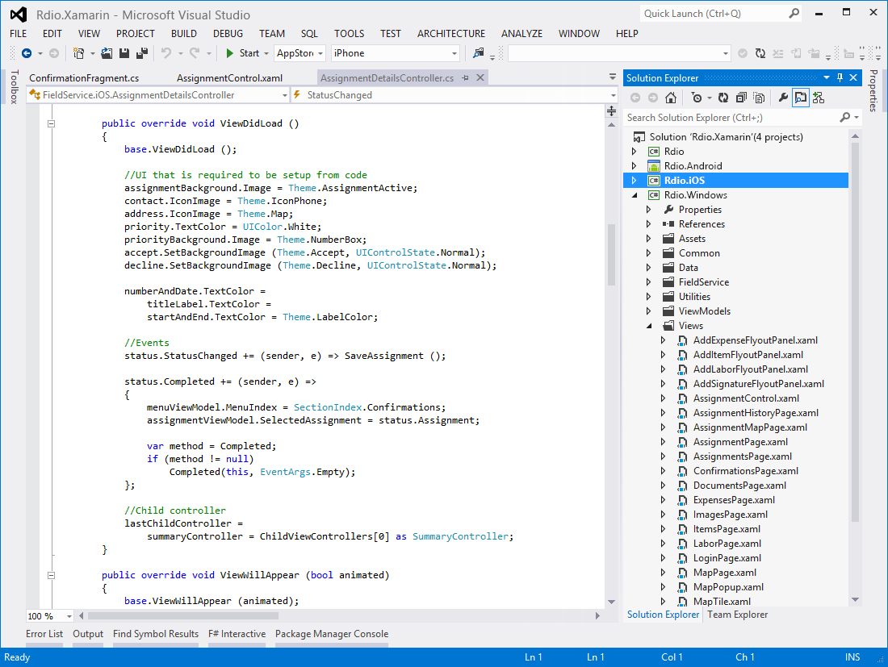
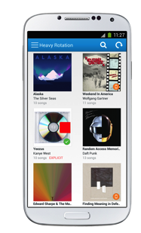

Create native iOS, Android, Mac and
Windows apps in C#
Automatically test your app on
hundreds of mobile devices
Notes:
Xamarin has 2 Main products.
You probably know of the Xamarin Platform enabling you to create iOS, Android, Mac and Windows
From either Xamarin Studio on a Mac or Visual Studio on a PC
We will talk about this a little bit more , but they also have Xamarin Test Cloud
Test Cloud is an upcoming service currently in Beta where you can upload your iOS or Android app (built with or without Xamarin (java/objectivec)
UI Tests are run on Hundred of physical devices.

Slide 4
Architecting Mobile Apps
Notes:
First, let’s talk a little bit about how you can create apps today

Slide 5
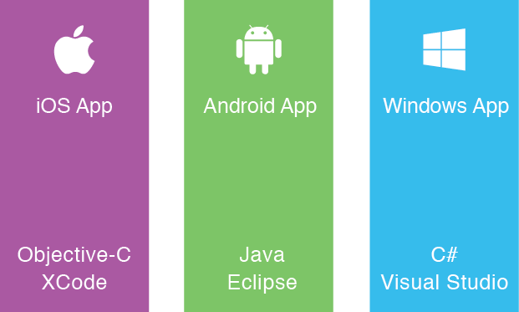
Silo
Approach
Build Apps
Multiple Times
Notes:
First is the Silo approach.
This is very common, where you see a company or developer
creating an app multiple times in different languages with different tools
Expensive, multiple teams, takes more time

Slide 6
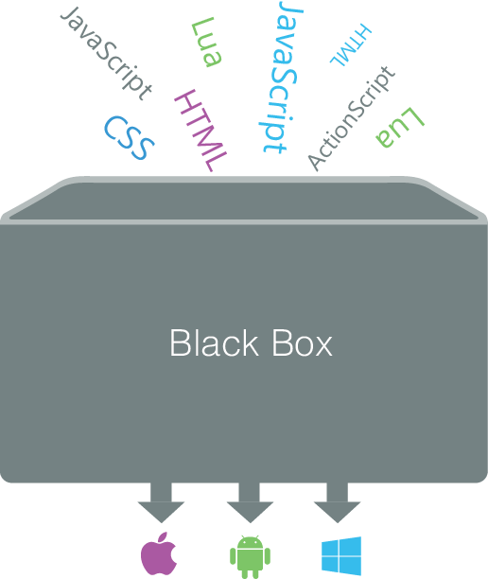
Write Once,
Run Anywhere
Approach
Lowest
Common
Denominator
Notes:
When people think of cross platform they think of this
Some magic box where html and javascript of sorts go in and apps magically come out
The issue here is you are coding again their api, not THE api

Slide 7
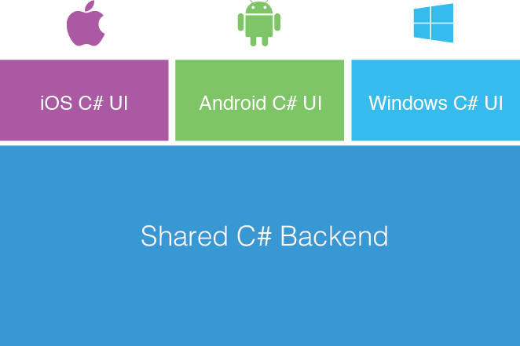
Xamarin’s Unique Approach
Native with Code Sharing
Notes:
Fully native apps written in C#
Share on average 75% source code across platforms
Even higher with xamarin.forms
C# + .NET Runtime
Native UI
Native Performance

Slide 8
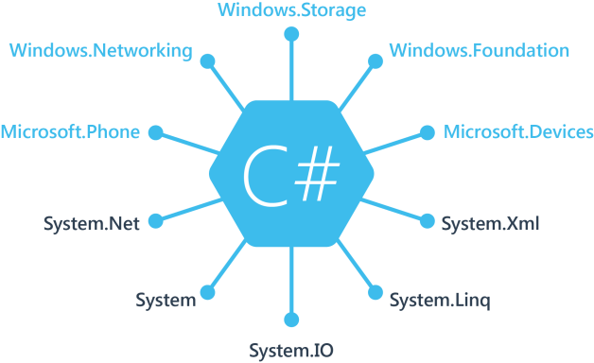
Windows
APIs
100%
Coverage
Notes:
If you are a windows developer you will be used to these name spaces.
These are the core .NET base libraries that we know and love.
If you mix in windows phone and windows store development you get new namespaces
Windows. And Microsoft. With platform specific APIs

Slide 9
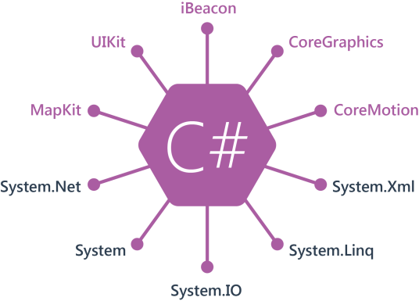
iOS
APIs
100%
Coverage
Notes:
Xamarin gives you the best of both worlds with full support for the .NET Framework (your System. Libraries)
Then they create C# bindings for every API in iOS and Android
As you can see here there are a few, CoreGraphics, CoreMotion, etc,
These are your platform specific bits to take advantage of everything in iOS

Slide 10
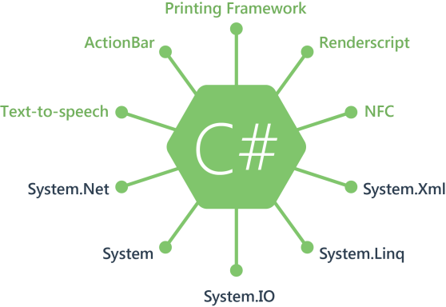
Android
APIs
100%
Coverage
Notes:
Then they do the same thing for Android so here you get the Android specifics
Renderscript, NFC to do cool phone tapping of data transfer
And text to speech apis to make your app shine

Slide 11
Anything you can do in Objective-C, Swift, or Java, can be done in C# with Xamarin

Slide 12
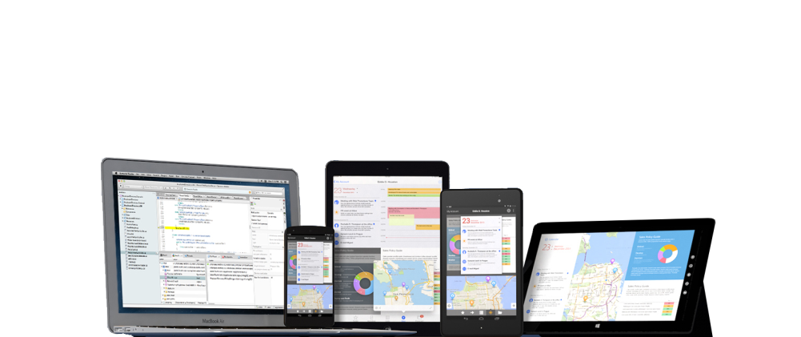
C# runs on 2.6 Billion Devices

Slide 13
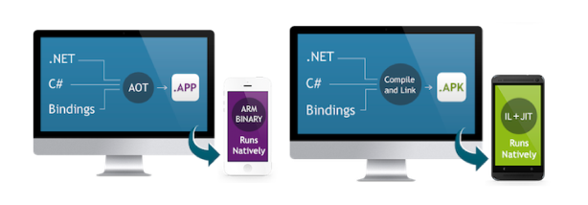
C# + .NET Runtime
Native UI
Native Performance
How
Xamarin
Works
Notes:
On iOS Xamarin Compiles the C# down to IL (intermediate language)
Then Xamarin create LLVM bit code
Then the LLVM bit code runs through the same LLVM Compiler and Optimizer that apple users for objective-c code
Creating the final native arm binary.
On Android they use an advanced compiler and linking to IL and
then JIT to create native instructions at runtime for optimal performance which often can be faster than the dalvik runtime.

Slide 14
What’s new in Xamarin 3

Slide 15
Xamarin Designer for iOS
Major IDE Enhancements
Improved Code Sharing
Xamarin.Forms
Major Elements in
Xamarin 3

Slide 16
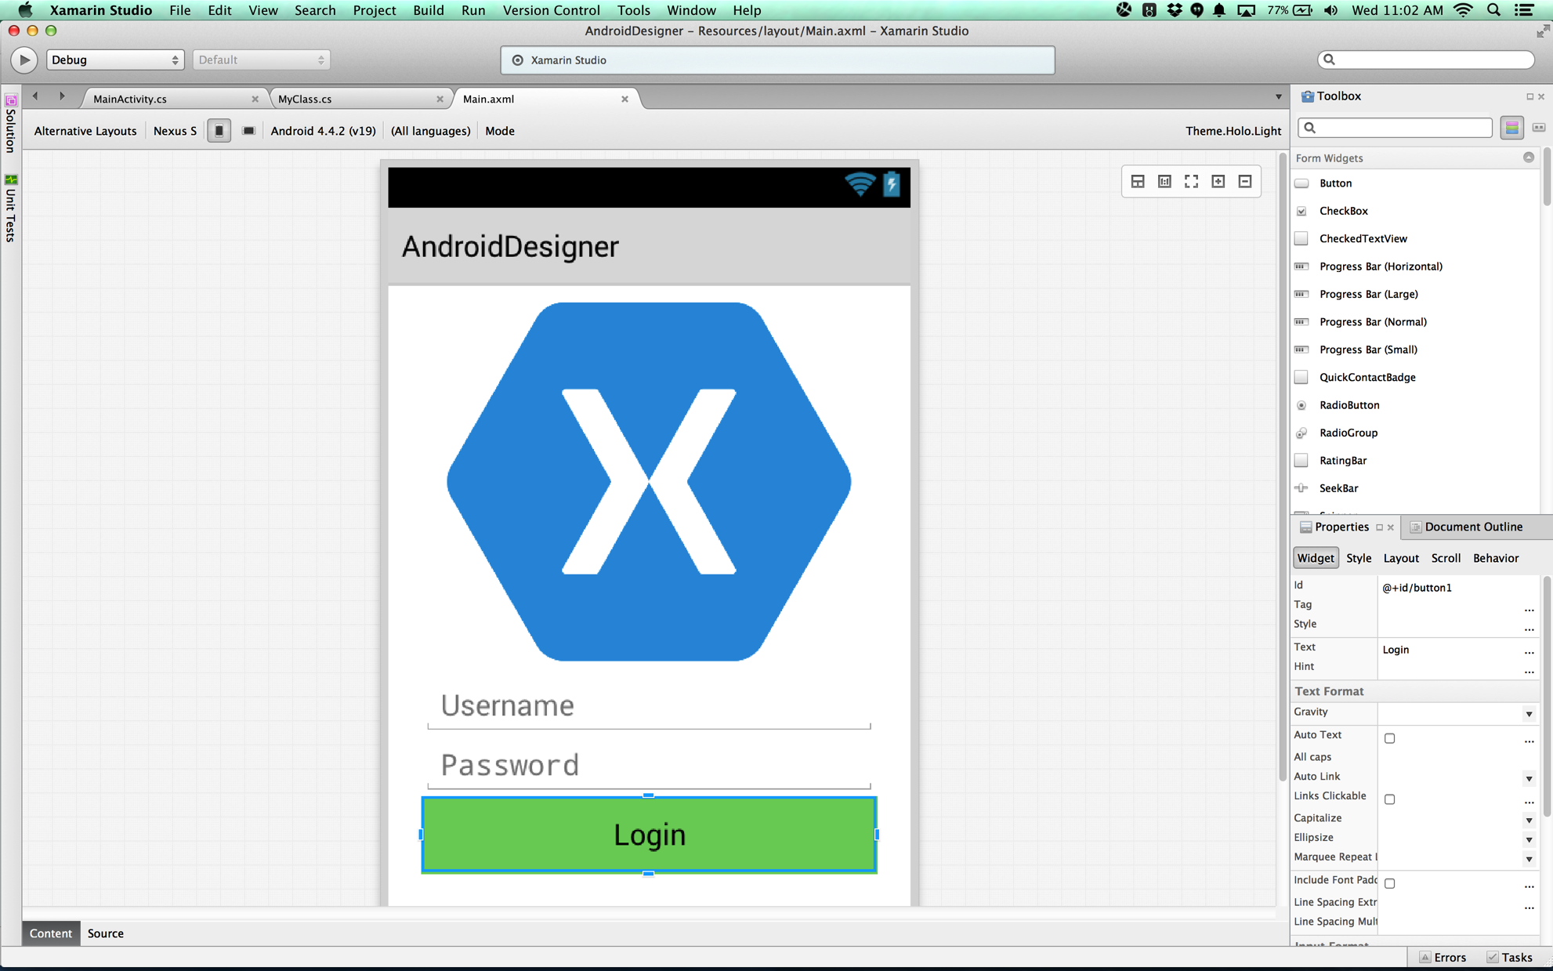
Xamarin Designer for Android
Fully integrated into Xamarin Studio & Visual Studio
Multi-resolution editing
Easy switch between design and Android XML
Shipping for over 2 years
Notes:
If you didn’t know Xamarin has shipped an Android designer for over 2 years
In both Visual Studio and Xamarin Studio
Features multi-layout view editing to make it easy to design for phone, small tablet, and large tablets

Slide 17

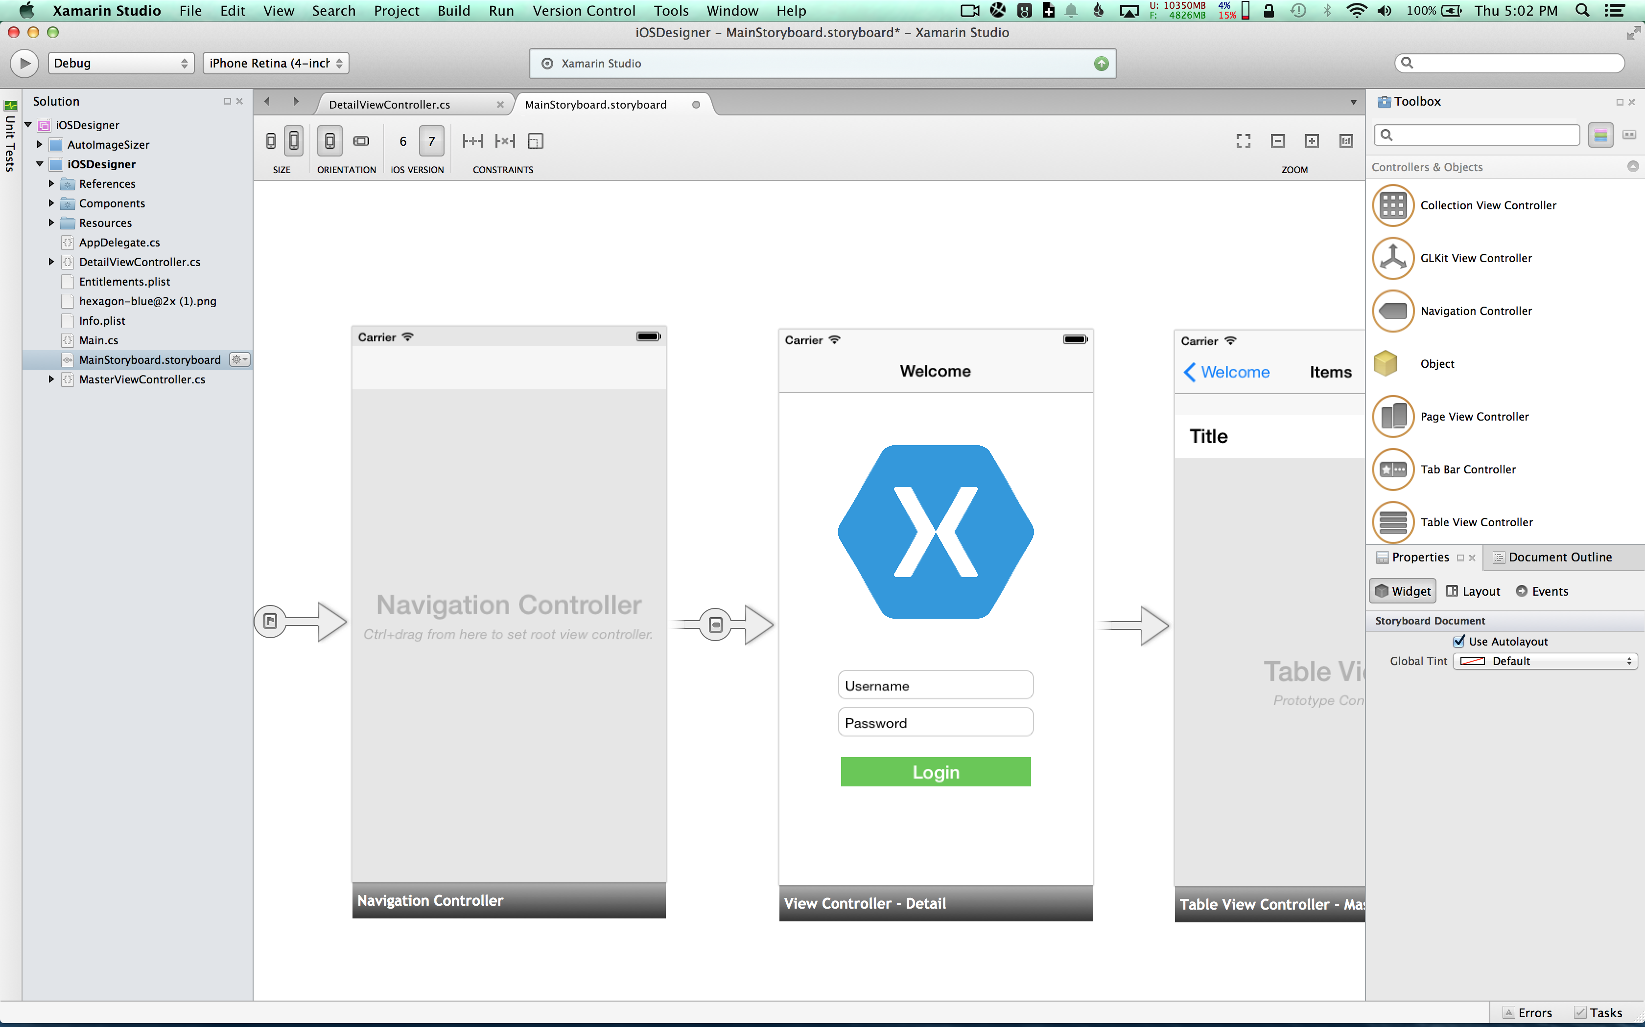
Xamarin Designer for iOS
Fully integrated into Xamarin Studio & Visual Studio
iOS 6 & 7 Storyboard support
Intuitive event handling
Support for auto-layout
Live preview of custom controls
Notes:
iOS UI design in the IDE
Using a model familiar to VS and XS users
Create event handlers from the IDE
Complete support for all new Apple design features
Unique feature: Live preview, no gray boxes here

Slide 18
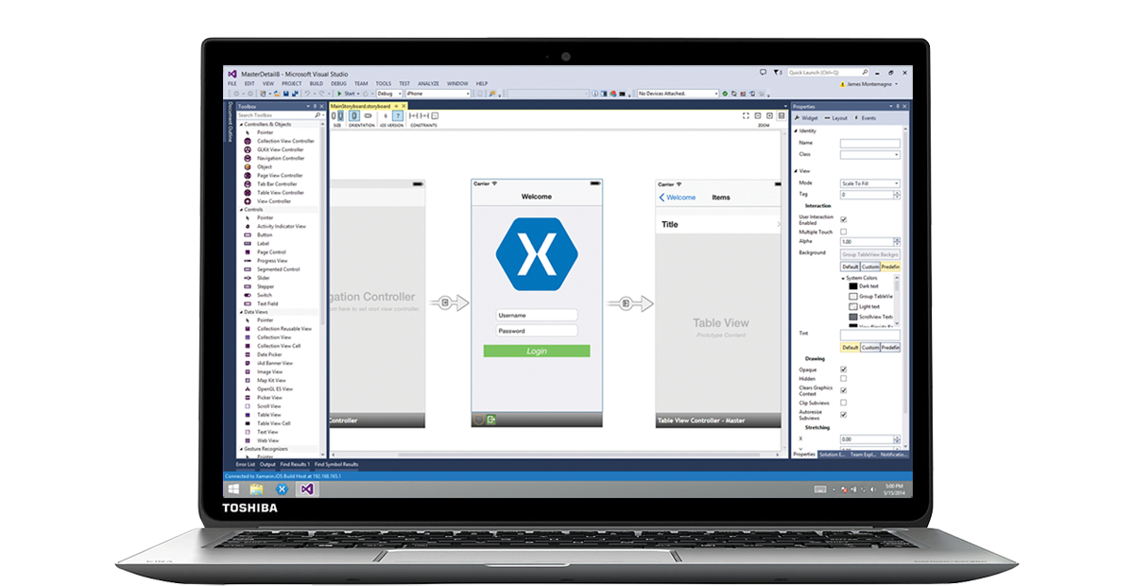
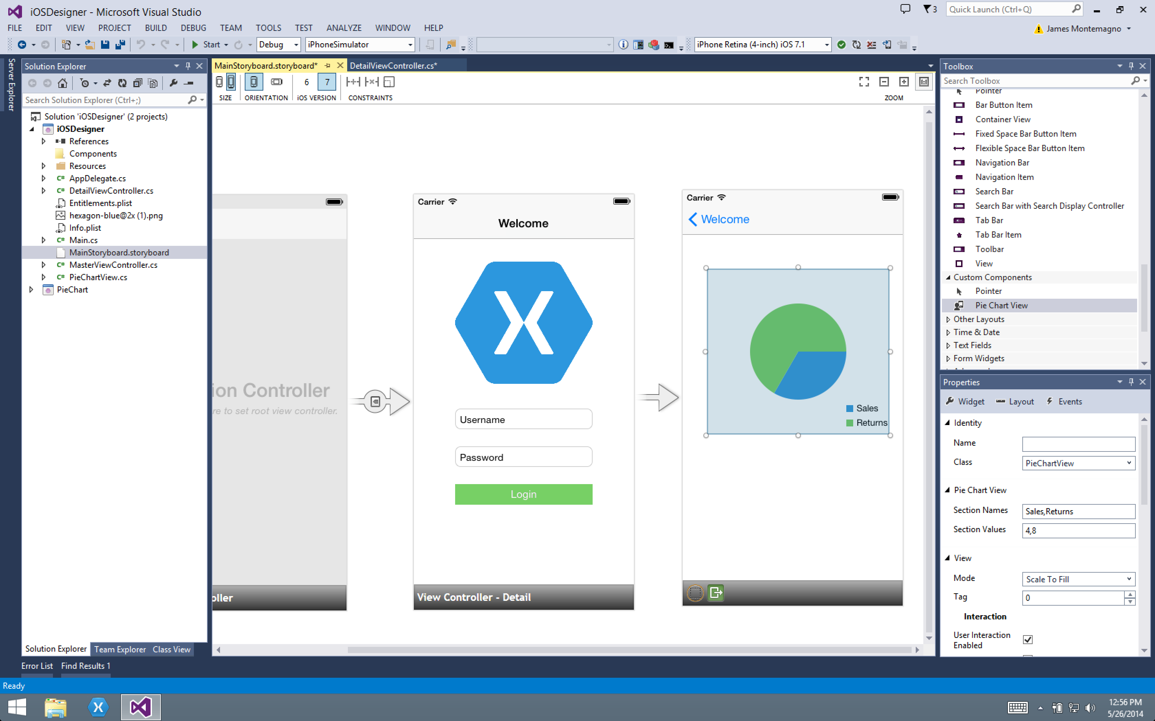
Xamarin Designer in Action
Notes:
Short video of designer in action if you can’t demo it

Slide 19
DEMO

Slide 20
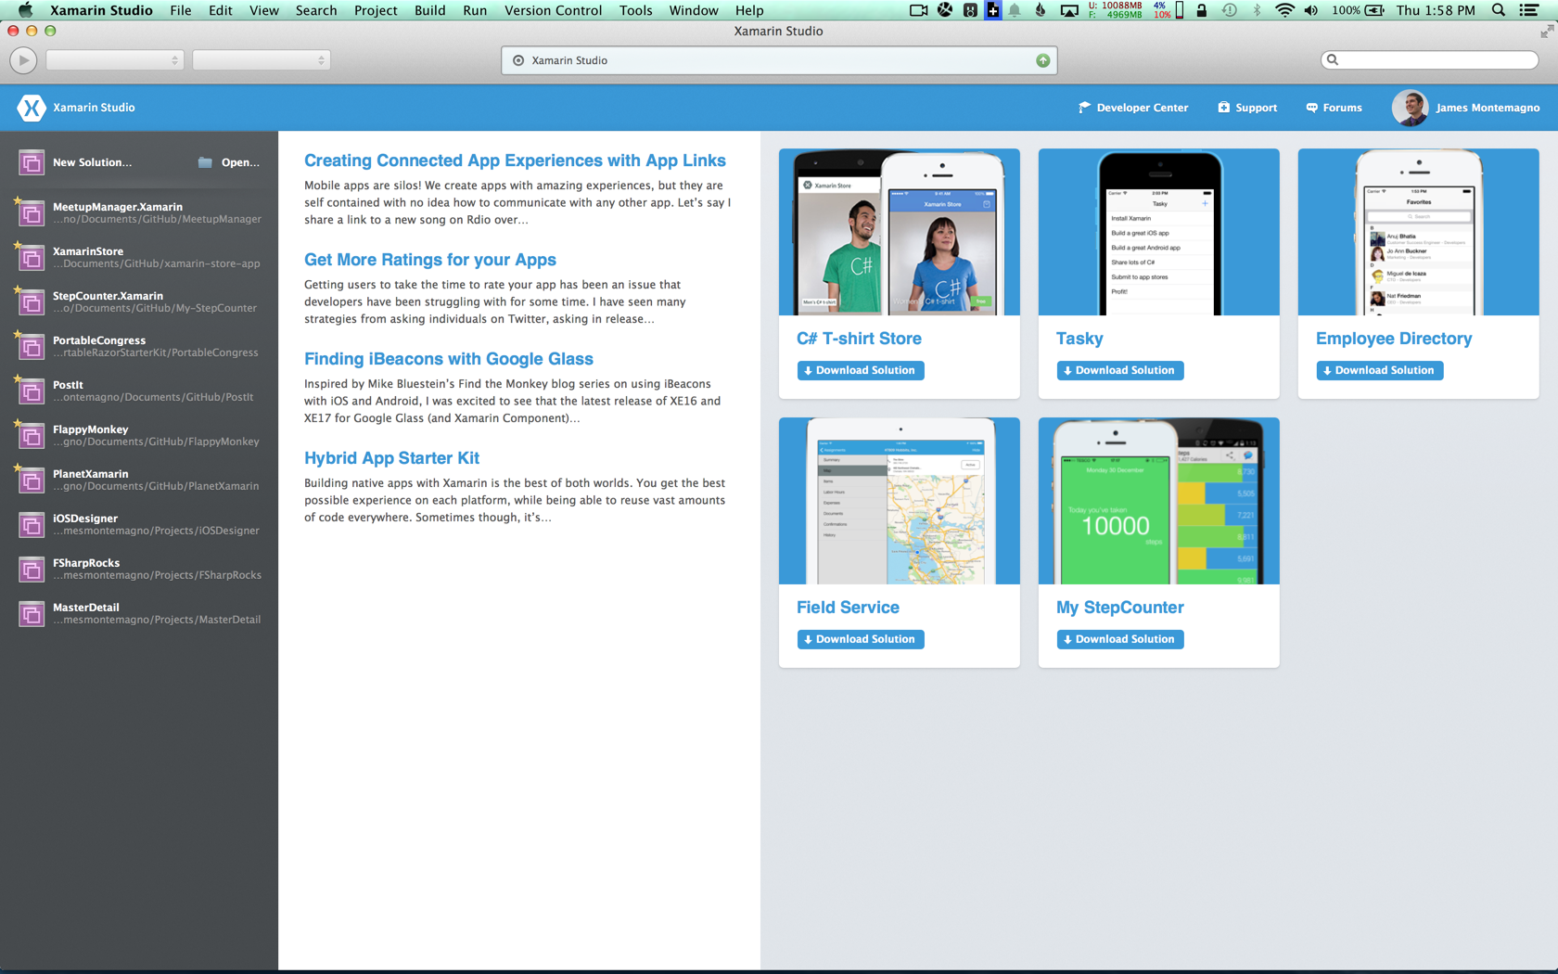
Xamarin Studio: Beautiful New Look
Notes:
Our IDE for Windows and Mac
Many iOS developers tend to develop on the Mac
Refreshed our user interface Added high-resolution artwork to support Retina displays
Brand new developer center
Easy access to information and samples
Hundreds of new icons

Slide 21
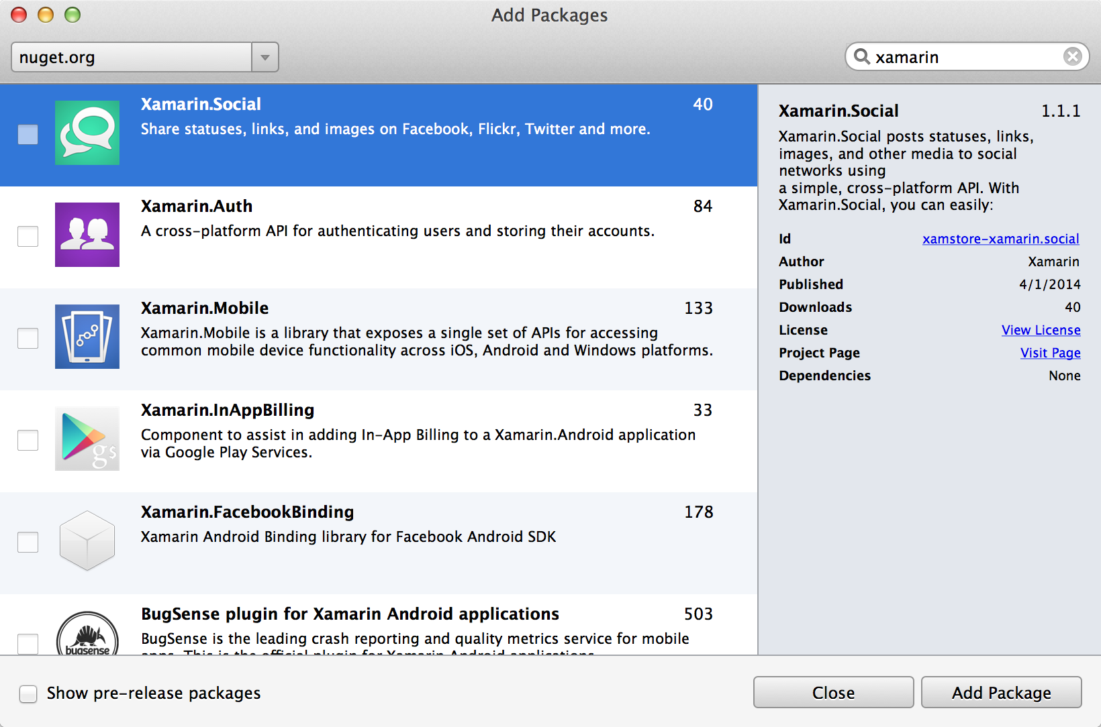
NuGet Package Manager
Full support for using NuGet packages
Take advantage of the many NuGet packages which are are now shipping with Xamarin compatibility – in Visual Studio or Xamarin Studio
Notes:
Fully integrated Nuget Package Manager
Beautiful UI, easy to add multiple packages
Includes dependency resolution
Includes private and custom feeds

Slide 22
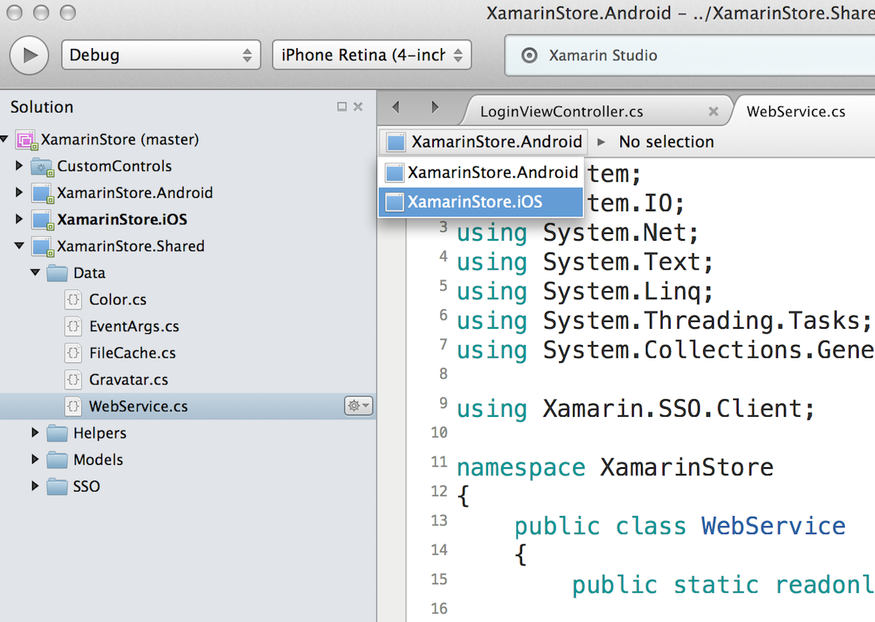
Shared Projects
The easiest way to share code
Eliminates the hassle of file-linking
Easier to collaborate with other Xamarin Studio and Visual Studio users
Notes:
Complements Portable Class Libraries (PCLs). PCLs enable Library developers to ship binaries that run on different platforms.
Introduced in Visual Studio Update 2, shared projects make it easy to share code files between projects.

Slide 23
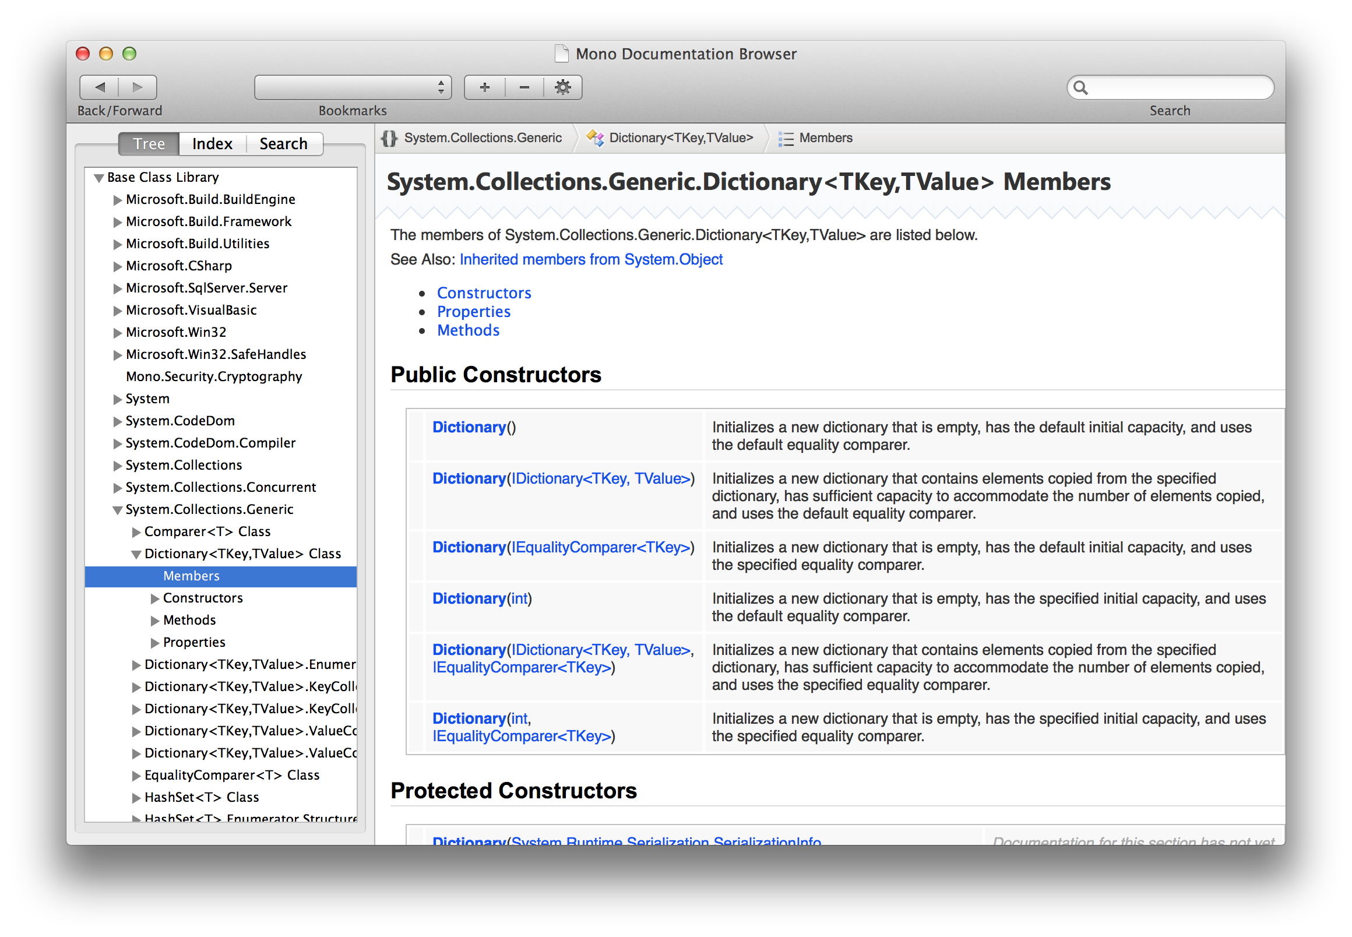
.NET BCL Documentation
Full documentation for the .NET Base Class Libraries (BCL)
Recently provided to community by Microsoft
Integrated into Xamarin Studio

Slide 24
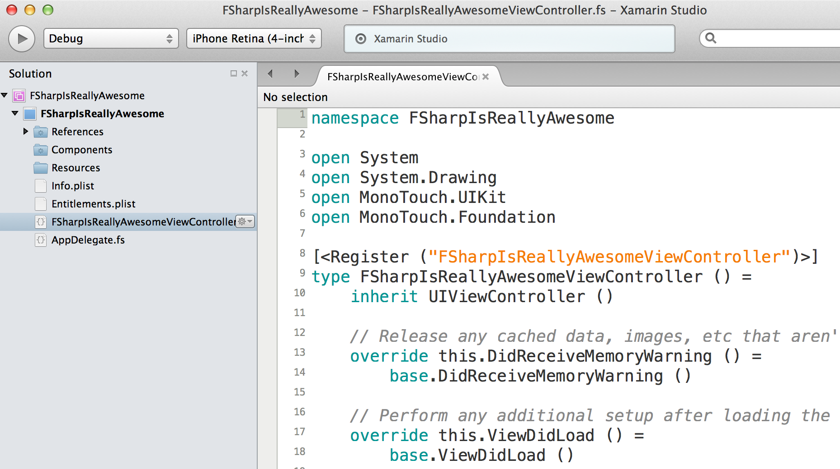
First Class F# Support
Notes:
Compact and productive language
Been around for a little while, nearly a year with xamarin support
About 50% less code than C#
Now for mobile development, built right in to Xamarin Studio

Slide 25
DEMO

Slide 26
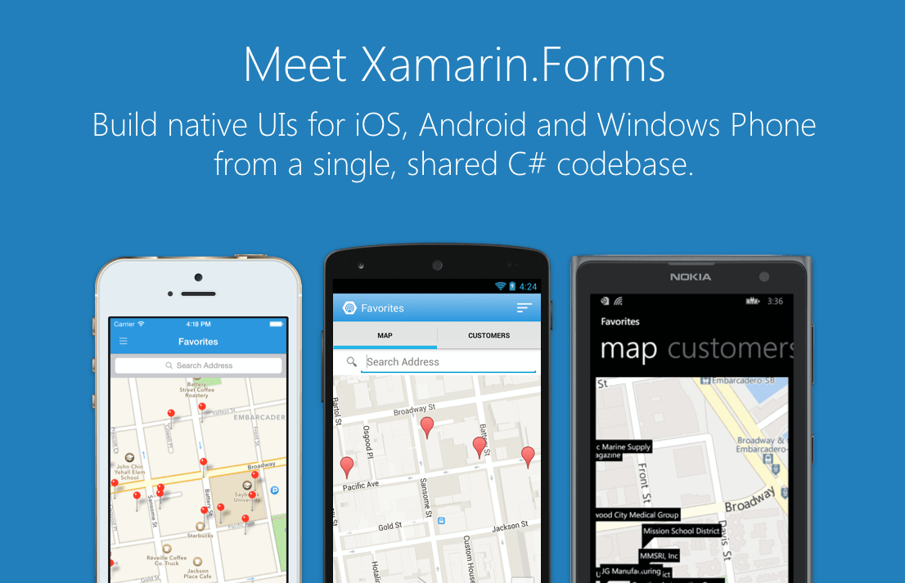
Portable Class Libraries
Notes:
Xamarin Forms is a new set of APIs allowing you to quickly and easily write shared User Interface code that is still rendered natively on each platform, while still providing direct access to the underlying SDKs if you need it.

Slide 27
Xamarin + Xamarin.Forms
With Xamarin.Forms:
more code-sharing, native controls
Traditional Xamarin approach
Shared UI Code
Notes:
We see here the Xamarin approach we talked about earlier
This enables you to be highly productive, share code, but build out UI on each platform and access platform APIs
With Xamarin.Forms you now have a nice Shared UI Code layer, but still access to platform APIs
Entire optional Technology
You can start from native, pick a few screens, or start with forms, and replace with native later

Slide 28
Xamarin + Xamarin.Forms
Quickly and easily build native user interfaces using shared code
Xamarin.Forms elements map to native controls and behaviors
Mix-and-match Xamarin.Forms with native APIs
Shared UI Code
Notes:
I

Slide 29
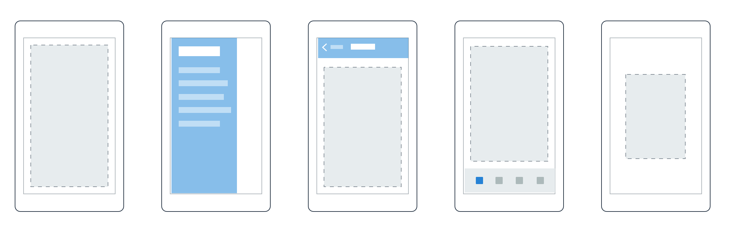

Pages
Content
MasterDetail
Navigation
Tabbed
Carousel
Notes:
First you have a set of pages for each screen of your application
There are things like Content, and MasterDetail which gives you a nice flyout
With a tabbed view you get the correct look on each platform
iOS on bottom, Android on top, and on WP you have a Pivot control

Slide 30
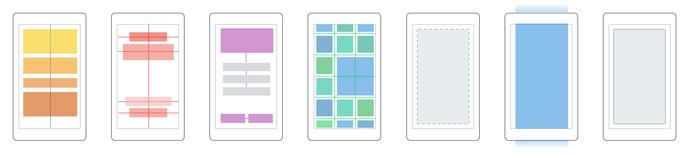
Layouts
Stack
Absolute
Relative
Grid
ContentView
ScrollView
Frame
Notes:
Inside of a page are layouts
A lot of options from something simple like a stack panel to complex and powerful grids

Slide 31
Controls
ActivityIndicator
BoxView
Button
DatePicker
Editor
Entry
Image
Label
ListView
Map
OpenGLView
Picker
ProgressBar
SearchBar
Slider
Stepper
TableView
TimePicker
WebView
EntryCell
ImageCell
SwitchCell
TextCell
ViewCell
Notes:
You have more than 40 controls, layouts, and pages to mix and match from.
These are all of the controls you have out of the box, you can of course create your own.
What is unique is you get the native control and have access to it.
Consider an Entry Field
On iOS it is mapped to UITextField
Android it is EditText
Windows Phone it is a TextBox

Slide 32
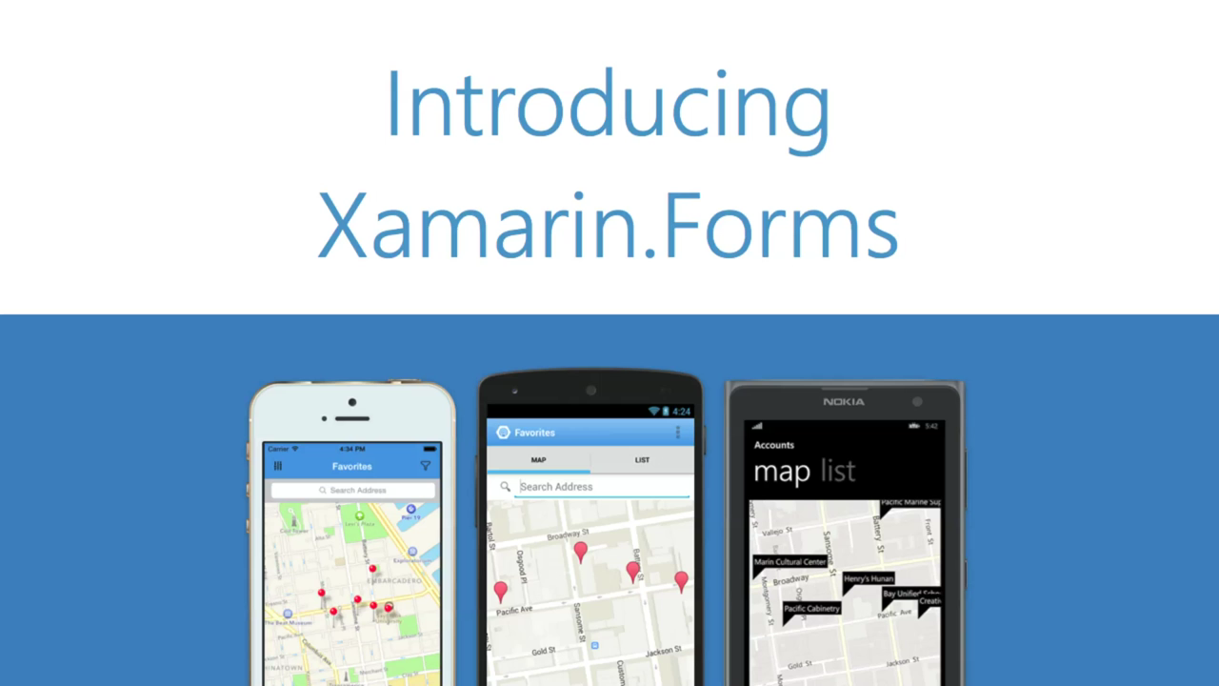
Xamarin.Forms in Action
Notes:
If you need to you can watch a short video here

Slide 33
DEMO

Slide 34
Xamarin 3 Recap
Xamarin Designer for iOS
Major IDE Enhancements
Improved Code Sharing
Xamarin.Forms
So much more!

Slide 35

Try Xamarin
Today
Notes:
To get started and get your own free C# t-shirt just go to xamarin.com/shirt
Shipped for free right to your door.

Slide 36

Learn more
Unrivaled Mobile Development Training
Live unlimited mobile development training from mobile experts, in your time-zone, on your schedule and as often as you'd like
Notes:
New courses available today for:
Xamarin.Forms
iOS Designer
New Code Sharing Strategies and more
Become a Certified Mobile Developer

Slide 37


Key Attendees

Slide 38

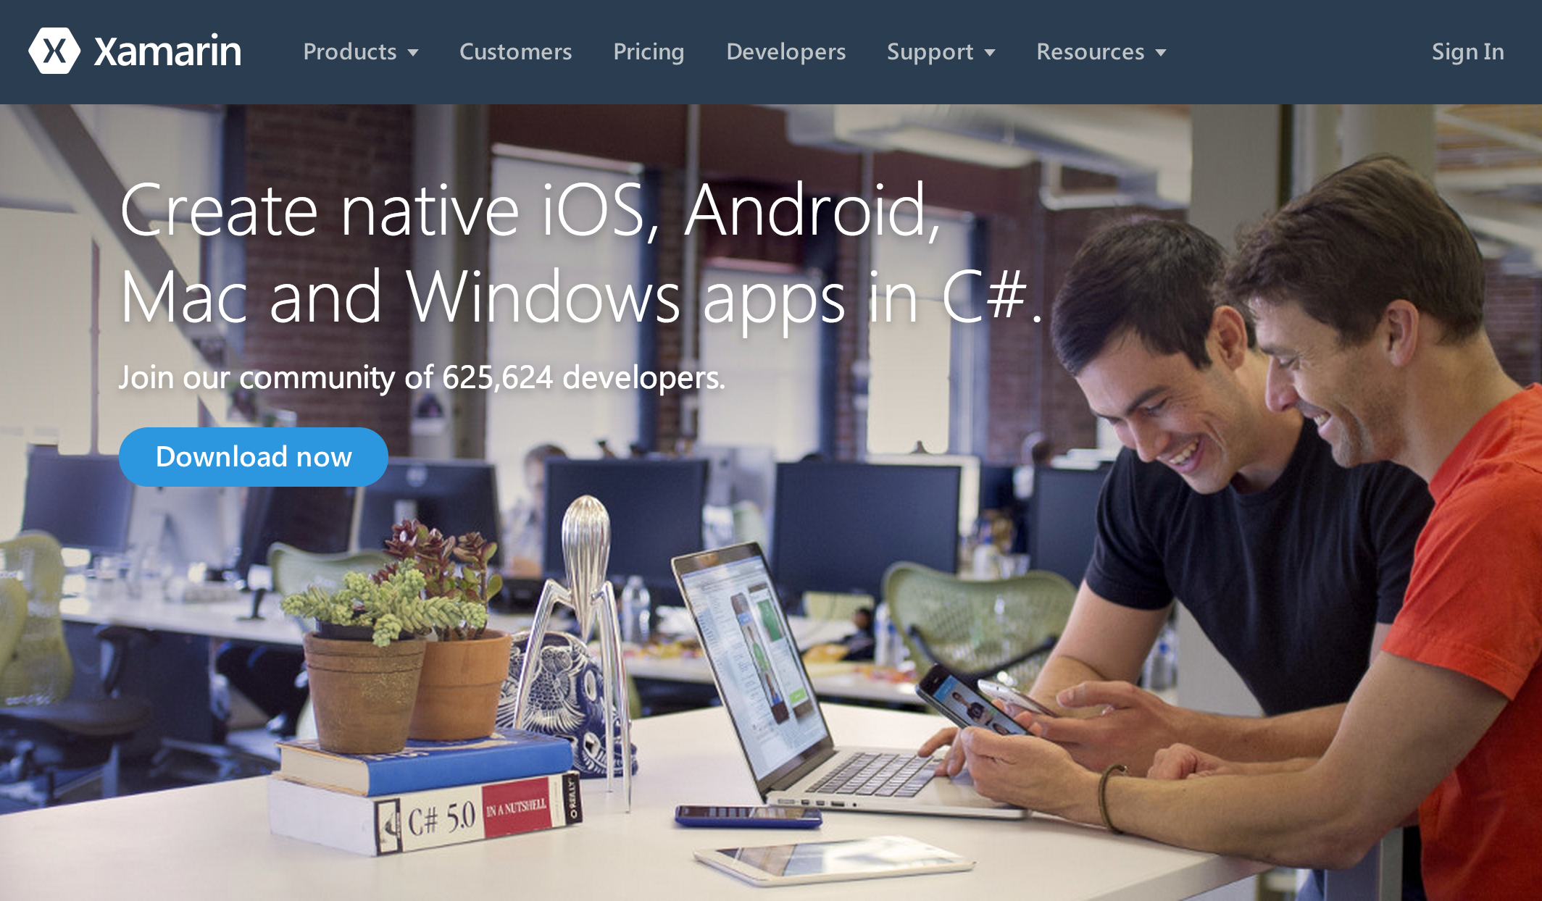
Get Started Today: xamarin.com/download

